Slide 1
Topic 6
Dynamic array vs. linked list
資料結構與程式設計
Data Structure and Programming
11/07/2018

Slide 2
In the following topics,
we will introduce several special types of
Data Structures,
for example, list, array, set, map, hash, graph, etc.
Some people call them
Abstract Data Types (ADT)
or (an easier-to-understand name)
Container Classes

Slide 3
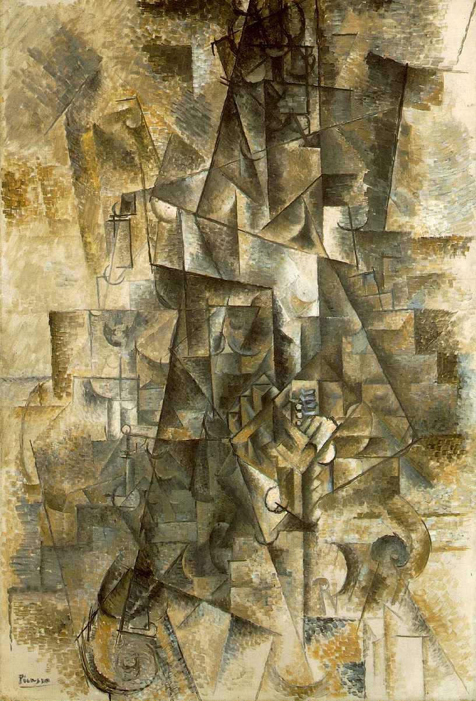
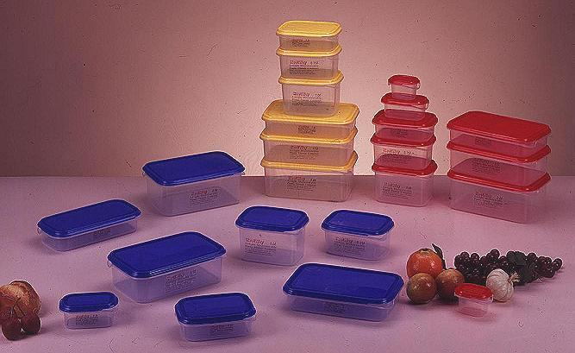
Saver Containers
Abstract ?? Containers??
Pablo Picasso, “Accordionist”

Slide 4
Abstraction
abstract model
Problem
.
abstraction
abstraction
.
Model
Notes:
選學生 男女朋友
自由落體

Slide 5
Data Types
“A data type, as defined in many object-oriented languages, is a class”
  Data member
    Define data
  Member functions
    Define operations
So, what does the “Abstract” in “Abstract Data Type” mean?

Slide 6
Some Quotes about ADT...
“...precisely specified independent of any particular implementation”
“You don't know how the ADT computes, but you know what it computes”
“The implementer of the class can change the implementation for maintenance, bug fixes or optimization reasons, without disturbing the client code”

Slide 7
ADT in Programming
Obviously, these kinds of classes are not specific to any type of algorithms
  In other words, they can be implemented independently of the algorithms that use them
What they provide ---
  Interface functions to operate on the data stored in the class
  The implied complexity of these functions
What they don’t show (Abstracted away...) ---
  What are the data members inside?
  How the functions are implemented?

Slide 8
ADT in Programming
That’s why they are called “Abstract Data Types”, or “Container Classes”, and usually treated as special “utilities” for a programmer
  Examples are:
    List, array, queue, stack, set, map, heap, hash, string, bit vector, matrix, tree, graph, etc.
The more and cleverer you use them, the better your program will be
  That’s the main purpose of learning this course

Slide 9
Classification of ADTs
Linear (Sequence) Data Types
  List, array, queue, stack
Associative Data Types
  Set, map, hash, heap
Topological Data Types
  Tree, graph
Miscellaneous Types
  String, bit vector, matrix
Usually OOP programmer will implement these classes just once (or adopt the existing ones), and later utilize them in various programs

Slide 10


Basic Concepts of Linked List
An abstract data type in which the data are linked as a list
head
tail
data
to next node
pointer

Slide 11
Linked List Implementation (I)
Simple C-style implementation
  struct MyStruct
  {
  // define data here...
  int _id;
  string _name;
  // define the pointer here...
  MyStruct* _next;
  };
  struct MyTop
  {
  MyStruct* _dataList;
  MyStruct* _dataPointer;
  };
data and pointer mixed together
list and pointer not distinguished

Slide 12
Linked List Implementation (II)
Data encapsulation → Abstract Data Type
→ Like a container
  class MyClass
  {
  // define data here..
  int _id;
  string _name;
  };
  class ListNode
  {
  MyClass _data;
  ListNode* _next;
  };
  class List
  {
  ListNode* _head;
  ListNode* _tail;
  };
  class MyTop
  {
  List _dataList;
  MyClass* _dataPtr;
  };

Slide 13
In other words...
class MyTop
class List
class ListNode
class ListNode
class MyClass
class MyClass
ListNode*
ListNode*
_head
_tail

Slide 14
More memory usage with data encapsulation??
Simple C-style implementation
  struct MyStruct
  {
  int _id;
  string _name;
  MyStruct* _next;
  };
  struct MyTop
  {
  MyStruct*
  _dataList;
  };
C++ implementation with data encapsulation
class MyClass
  {
  int _id;
  string _name;
  };
  class ListNode
  {
  MyClass _data;
  ListNode* _next;
  };
  class List
  {
  ListNode* _head;
  };
However, whenever we need a list with different data type, we still need to define a new List class

Slide 15
Linked List Implementation (III)
Template implementation
  template <class T>
  class ListNode
  {
  T _data;
  ListNode<T>* _next;
  };
  template <class T>
  class List
  {
  ListNode<T>* _head;
  ListNode<T>* _tail;
  };
One implementation
multiple instantiations
List<int> intList;
List<char> charList;
List<MyClass> myList;
...

Slide 16
Complexity Analysis
(Singly Linked List)
class List
class ListNode
class ListNode
class MyClass
class MyClass
ListNode*
ListNode*
_head
_tail
push_front(d) {
ListNode* liNode
= new ListNode(d);
liNode->_next
= _head;
_head = liNode;
}
push_back(d) {
ListNode* liNode
= new ListNode(d);
_tail->_next
= liNode;
_tail = liNode;
}
// Any corner case?
// What if “_tail” is NOT known?

Slide 17
Complexity Analysis
(Singly Linked List)
class List
class ListNode
class ListNode
class MyClass
class MyClass
ListNode*
ListNode*
_head
_tail
pop_front() {
ListNode* liNode
= _head;
_head
= _head->_next;
delete liNode;
}
// What if “_head == NULL”?
pop_back() {
………
delete _tail;
………
}
// How to find the one in front of _tail?

Slide 18
Complexity Analysis (Singly Linked List)
push_front()
push_back()
pop_front()
pop_back()
size()
empty()
insert(pos, data)
erase(pos)
find(data)
O(1)
O(1) // if tail is known, else O(n)
O(1)
O(n) // even if tail is known
O(n) or O(1)
O(1) // complexity not equal to (size() == 0)
O(n) (before pos) or O(1) (after pos)
O(n)
O(n)

Slide 19
Singly vs. Doubly Linked List
Some operations, like “erase(node)”, have linear complexity for singly linked list (Why?)
  Don’t know the previous nodes
Doubly Linked List
class List
class ListNode
class MyClass
class MyClass
ListNode*
ListNode*
ListNode*
ListNode*

Slide 20
Memory Overhead
Assume (64-bit machine)
  Pointer: 8 Bytes
  Data: d Bytes
  Total: n data
Overhead = total memory – data memory
  Data memory = d * n
Singly Linked List: (d + 8) * n + 8 * 2
  Overhead = 8 * n + 16 (~ 8Bytes/data)
Doubly Linked List: (d + 16) * n + 8 * 2
  Overhead = 16 * n + 16 (~ 16Bytes/data)

Slide 21
Complexity Analysis (Doubly Linked List)
push_front()
push_back()
pop_front()
pop_back()
size()
empty()
insert(pos, data)
erase(pos)
find(data)
O(1)
O(1)
O(1)
O(1)
O(n) or O(1)
O(1) // != (size() == 0)
O(1)
O(1)
O(n)

Slide 22
“Find” Operation
One common way to speed up “find” operation is to keep the data always sorted
  [Note] Binary Search: O(log₂ n)
But, can we implement “binary search” using Linked List?
 | 10 | 100 | 1000 | 10K | 100K
O(1) | 1 | 1 | 1 | 1 | 1
O(log₂ n) | 4 | 7 | 10 | 14 | 17
O(n) | 10 | 100 | 1000 | 10K | 100K

Slide 23
Why not?
Linear access
vs.
Random access

Slide 24
Access a ListNode & Traverse a List
  template <class T>
  class ListNode
  {
  T _data;
  ListNode<T>* _next;
  };
  template <class T>
  class List
  {
  ListNode<T>* _head;
  ListNode<T>* _tail;
  };
➔ for (ListNode<T>* node = myList.getHead();
node != 0; node = node->getNext()) {
... }
Does user need to know how List is implemented?
why not “node != myList.getTail()”?

Slide 25
List Iterator
In many standard List implementations, “class ListNode” is actually hidden from the user ---
  Why should user know about the class “ListNode”?
    User only interfaces with “class List”
    The internal data field “ListNode*” is just one way of implementing “List”
Use a generic interface class “List Iterator” to traverse a List

Slide 26
The Goal...
iterator li;
for (li = myList.begin();
li != myList.end(); li++)...
--------- (compared to) ---------
ListNode<T> *n;
for (n = myList.head();
n != 0; n = n->getNext();
➔ Overload “=“, “!=“, “++” for class iterator

Slide 27
List Iterator Implementation
class iterator {
// Conventionally, use lower case “i” for “iter...”
ListNode<T>* _node;
public:
iterator(const ListNode<T>* const n = 0):
_node(n) {}
const T& operator *() const;
iterator& operator ++ ();
iterator operator ++ (int);
iterator& operator = (const iterator& i);
bool operator != (const iterator& i) const;
};
➔ Act as a “wrapper class” for ListNode<T>*

Slide 28
But the question is:
“How to distinguish this generic iterator class from others?”
(iterators for Linked List, Array,… etc)
➔ One possible way is to declare it inside the “List” class

Slide 29
List Iterator Implementation (cont’d)
template <class T>
class List {
ListNode<T>* _head;
ListNode<T>* _tail;
// Conventionally, use lowercase “i”
class iterator {
ListNode<T>* _node;
public:
iterator(const ListNode<T>* const n = 0):
_node(n) {}
...
};
// implicitly calling the iterator(_head) constructor
iterator begin() { return _head; }
iterator end() { return 0; }
};
Why return ‘0’?
Is this a good implementation?

Slide 30
A List::iterator Example
int main() {
List<int> intList;
for (int i = 0; i < 10; ++i)
intList.push_back(i * 2);
List<int>::iterator li;
for (li = intList.begin();
li != intList.end(); li++) {
cout << *li << endl;
}
}

Slide 31
List<T>::push_back(const T& d)
void push_back(const T& d) {
ListNode<T>* t
= new ListNode<T>(d, 0);
if (_tail != 0)
_tail->setNext(t);
else // _head = _tail = 0
_head = t;
_tail = t;
}
[Question] Who frees the ListNode* memory?
  template <class T>
  class ListNode {
  T _data;
  ListNode<T>* _next;
  };

Slide 32
Object or pointer data in a List
When the destructor of
ListNode<T> is called,
will the destructor of
_data be called?
  Yes, if _data is an object type
  No, if _data is a pointer type
Uh? Memory leak?
  NO!! If _data is an object type, then it is a COPY of the data outside the List.
  If it is a pointer, then it shares the same data storage. You can’t delete it by List.
  template <class T>
  class ListNode {
  T _data;
  ListNode<T>* _next;
  };

Slide 33
List<T>::pop_front()
void pop_front() {
if (empty()) return;
ListNode<T>* t = _head->getNext();
delete _head;
_head = t;
}
[Question] How about “_tail”?
When should we care?
[Question] How about “_data” inside “_head”? Will it be destructed or “deleted”?

Slide 34
Destructors of List and ListNode
ListNode<T>::~ListNode() {
// Do nothing.
// But Will call the destructor of “T _data”
// But if “T” is a pointer type,
// ➔ will not free the memory it points to.
}
List<T>::~List() {
ListNode<T>* thisNode = _head;
while (thisNode != 0) {
ListNode<T>* nextNode = thisNode->getNext();
delete thisNode;
thisNode = nextNode;
}
}

Slide 35
Note about the “end()”
Remember, in STL, “end()” actually points to the next to the last node.
In the previous example, we return ‘0’ for “end()”
➔ Any problem?
  Potential misjudgment on “n == end()”
  How to do backward traversal?
The solution in HW#5 (also in STL’s list<T>)
  Create a dummy ListNode<T>* as the end

Slide 36
Dummy ListNode<T>* as the end()
class List
class ListNode
class MyClass
class MyClass
ListNode*
ListNode*
ListNode*
ListNode*
_head
(dummy node)
class MyClass
_next
ListNode*
_prev
ListNode*

Slide 37
Dummy ListNode<T>* as the end()
Things to consider...
What happens when the List<T> is just constructed?
size(), empty()?
push_back(), push_front()
➔ need to properly update _head, _tail
pop_back(), pop_front()
➔ what happen if it has just one element or is empty?
Do we need “_tail”?

Slide 38
Sorting in Linked List
As we say, since the iterators in linked list are not randomly accessible, it’s not possible to implement binary search on it.
Sorting on Linked List: O(n²)
  Bubble sort, selection sort, etc.

Slide 39
Classification of ADTs
Linear (Sequence) Data Types
  List, array, queue, stack
Associative Data Types
  Set, map, hash, heap
Topological Data Types
  Tree, graph
Miscellaneous Types
  String, bit vector, matrix
Usually OOP programmer will implement these classes just once (or adopt the existing ones), and later utilize them in various programs

Slide 40
Array vs. List
In many programmers’ view, “array” is less favorable than “list” because they think the array class is ---
  Limited in size (i.e. array bound)
  Expensive in “erase” operation
  No clear advantage other than “random access by index”
➔ That’s because they don’t know enough about “Dynamic Array”

Slide 41
Static Array
Array with fixed size // e.g. int arr[100];
“Insert/erase()” operation
  O(1) if inserted at the end
  If the element order is not important
    O(1) insert anywhere (how?)
    O(1) erase
  If the element order does matter
    O(n) insert at the beginning or anywhere
    O(n) erase
    ➔ Is this common? (comparing to list...)
“Find()” operation
  Can have O(log₂ n) complexity (how?)

Slide 42
Static vs. Dynamic Array
Static array is indeed limited in usage, and may create memory problems
  Not recommended in general
Dynamic array removes the array size limitation, and when compared to linked list, its performance (runtime and memory) is actually much better
  Highly recommended

Slide 43
Basic Concept of Dynamic Array
_data
increase
array size
initial array size
copy
_size
_size
one more to insert
_capacity

Slide 44
Dynamic Array Implementation
template <class T>
class Array
{
T* _data;
size_t _size;
size_t _capacity
public:
Array(size_t t = 0)
: _size(t), _capacity(t) {
_data = initCapacity(t);
}
};

Slide 45
“Size” in Dynamic Array
[Note] In previous example, _size = t, not 0
➔ follow the semantics of STL
  We can access array[0 ~ (t-1)] after construction
[compare]
  Array<int> arr1; // size = 0
  arr1[0] = i; // Error!!
  arr1.push_back(i); // OK; size becomes 1
  Array<int> arr2(10); // size = 10
  arr2[0] = i; // OK
  arr2.push_back(j); // What’s the size now?

Slide 46
“Capacity” in Dynamic Array
Initialized in array constructor
When _size == _capacity, how to grow?
  ➔ Doubled (e.g. 2→4, 3→6, 5→10, etc)
  Issue: How to do memory management?
    Remember: difficult to recycle if different in size
  [Sol#1] Powered of 2 in memory allocation
  Issue: waste memory
    Many arrays may have size < 10, but only have capacity choices as {2, 4, 8, 16 }
  [Sol#2] Hybrid (1, 2, 3, ...7, 8, 16, ..., 2^{n}, ...)

Slide 47
Important Member Functions for Array
T& operator [] (size_type i);
const T&
operator [] (size_type i) const;
void push_back(const T& d) {
if (_size == _capacity)
expand();
data[_size++] = d;
}
void resize(size_type s);
// s can be smaller or larger than _size

Slide 48
Complexity Analysis (Dynamic Array)
push_front()
push_back()
pop_front()
pop_back()
size()
empty()
insert(pos, data)
erase(pos)
find(data)
O(n) or O(1) // if order not matters
O(1)
O(n) or O(1) // if order not matters
O(1)
O(1) // not O(n), why?
O(1)
O(n) or O(1) // if order not matters
O(n) or O(1) // if order not matters
O(n) or O(log n) // why?
If order does not matter, almost all operations are O(1)!!

Slide 49
Memory Overhead of Dynamic Array
Assume (64-bit machine)
  Pointer: 8 Bytes
  Data: d Bytes
  Total: n data
Overhead = total memory – data memory
  Data memory = d * n
Dynamic Array Overhead = 24 Bytes only (why??)
  (cf) Singly Linked List = 8 * n + 16
  (cf) Doubly Linked List = 16 * n + 16

Slide 50
The Data in the Array Can be Sorted
Option #1 (dynamic)
  Whenever a data is inserted, update the array so that the elements are in right order
  O(log n) in finding the place to insert; O(n) in updating the array
    ➔ Inserting n elements ➔ O(n²) // NOT O(n log n)
    ➔ Array may not be the best ADT
    ➔ In such case, “balanced binary search tree (BST)” (e.g. STL Set/Map) should be better
Option #2 (static)
  If we care about the order only after all the elements are inserted
    ➔ Sorted only once
    ➔ Inserting n elements ➔ O(n log n)
  Has the same “find()” complexity as “set” or “map”, but much less runtime and memory overhead than BST!!

Slide 51
Some notes about the Array<T> in HW#5
Don’t worry about sorting for Array<T>, we call STL:
  void sort(RandomAccessIterator first,
  RandomAccessIterator last,
  StrictWeakOrdering comp);
  ➔ as lone as operator < is overloaded,
  you can use sort()
No need to implement class ArrayNode<T>. Why??
The capacity always grows from: 0 → 1 → 2 → 4 → 8 → ... → 2^{n}

Slide 52
Performance Comparison:
Dynamic Array vs. Linked List
Task 1
  Insert n data (1 by 1)
Task 2
  Insert n data (1 by 1)
  Destroy the ADT (remove all)
Task 3
  Alternatively insertions and deletions
Task 4
  Sort the data
(Try different scenarios and report in HW #5)

Slide 53
“vector” and “list” in STL
In fact, many wrapper classes around the real data members
In essence…
  class vector {
  T* _M_start;
  T* _M_finish;
  T* _M_end_of_storage;
  };
  class list {
  std::_List_node_base *_M_node;
  };
  class _List_node_base {
  std::_List_node_base *_M_next;
  std::_List_node_base *_M_prev;
  };

Slide 54
Other Linear ADT
Queue (also known as FIFO)
Stack (also known as FILO)
Use “adaptor class” to implement on top of other linear ADT
  For example,
  template <class T, class C = Array<T> >
  class Stack {
  C _elements;
  public:
  // only define operations
  // that make sense to “stack”
  // e.g. push(), pop(), top(), etc
  };

